Slide 1

Belgrade School of Computing
ESG Investing Using Expected Shortfall as a Measure of Risk
Belgrade, July 2024
Supervisor: Dr Branko Urošević
Student: Dragoljub Stošić

Slide 2
What were we trying to examine and understand better ?
Examine relationship between ESG factors and financial performance with focus on expected shortfall as a measure of risk.

Slide 3
“Of all the varying concerns that make up the social responsibility component of SRI, the environment is the most fundamental. Philosophically speaking, if the Earth's ability to life is essentially impaired, there seems little point in worrying about the other issues.”
Russell Sparkes - Socially Responsible Investment: A Global Revolution

Slide 4
Definition
ESG investing is an approach that incorporates Environmental, Social, and Governance factors into investment decisions, alongside traditional financial analysis.
Environmental factors consider a company's impact on nature, Social factors examine its relationships with employees, suppliers, customers, and communities, while Governance factors focus on corporate leadership, executive pay, audits, and shareholder rights.

Slide 5
Overview of different ESG factors - Clark et al., 2014
Environmental (“E”) | Social (“S”) | Governance (“G”)
Biodiversity/land use | Controversial business | Accountability
Carbon emissions | Customer relations/product | Anti-takeover measures
Climate change risks | Diversity issues | Board structure/size
Energy usage | Employee relations | Bribery and corruption
Raw material sourcing | Health and safety | CEO duality
Regulatory/legal risks | Human capital management | Executive compensation schemes
Supply chain management | Human rights | Ownership structure
Waste and recycling | Responsible marketing and R&D | Shareholder rights
Water management | Union relationships | Transparency

Slide 6
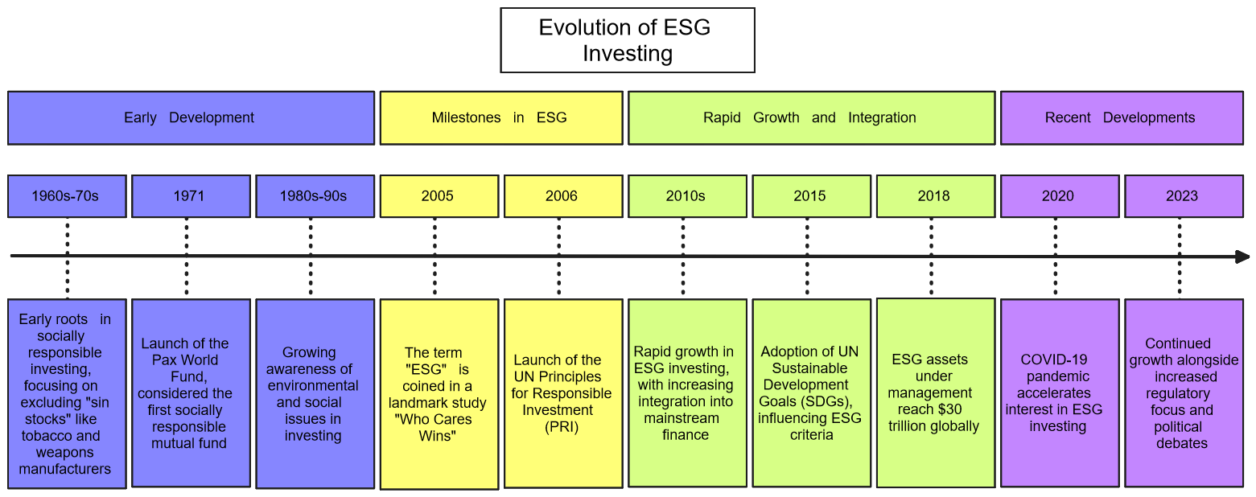
It might look like ESG is a new concept but ESG has a long history.

Slide 7
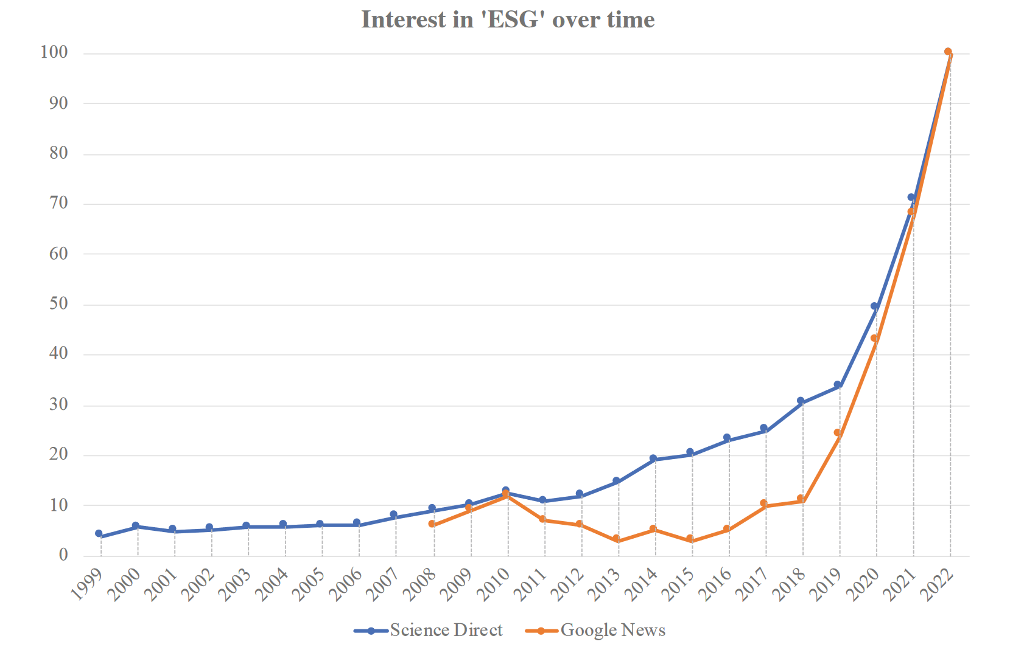
Interest evolution in the term ‘ESG’ in academic studies and press. Data from SciencedDirect.com (published articles) and Google Trends (News searches). (Gaganis et al., 2023)

Slide 8
Risk
Lot’s of definitions for risk depending on context
an event where the outcome is uncertain
probability that actual outcomes will deviate from expected outcomes
one of the central challenges in modern risk management is assessing risk - quantifying it
in finance: potential for losing financial investment or facing financial instability

Slide 9
Quantifying Risk in Finance
To quantify risk in finance, we use Value at Risk (VaR) and Expected Shortfall (ES) - among many other methods but here we focus on VaR and ES
Value at Risk (VaR) - Possible maximum loss over a given holding period within a fixed confidence level.
Expected Shortfall (ES) - is the average loss expected in the worst cases beyond the VaR threshold. It provides a more comprehensive view of tail risk.
ES typically provides a more conservative risk estimate than VaR

Slide 10
If VaR at 97.5% is 3%, then, there's a 97.5% probability that the portfolio's loss will not exceed 3% of its value over the specified time period - there's only a 2.5% chance of experiencing a loss greater than 3%.
If ES at 97.5% is 3%, then, the average loss in the worst 2.5% of scenarios is 3% of the portfolio's value. This means that when losses exceed the VaR threshold, the expected (average) loss in those worst-case scenarios is 3%.

Slide 11
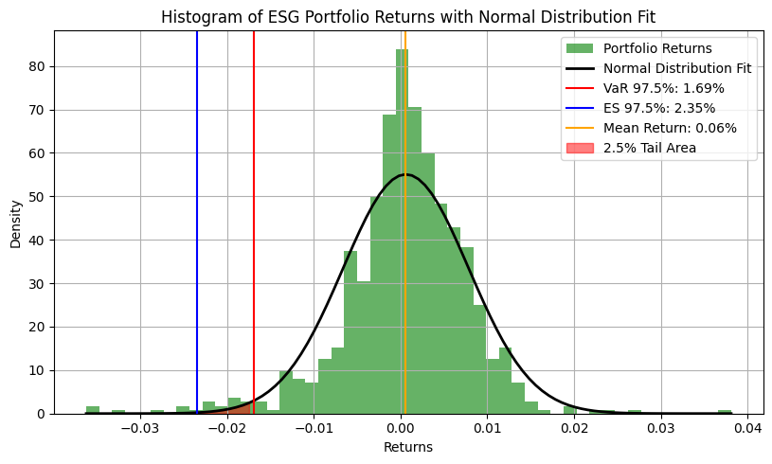
VaR and ES concepts illustrated
* One of the portfolios we analyzed in the thesis

Slide 12
Multi-Objective Evolutionary Algorithms (MOEAs) and Nondominated Sorting Genetic Algorithm II (NSGA-II)
John Holland (1975) first introduced the concept of genetic algorithms, based on Darwin's principle: "the fittest survive."
Inspired by nature, useful for complex optimization problems.
Multi-Objective Problems: Portfolio optimization involves conflicting objectives, requiring multi-objective approaches.
In fact all practical optimization problems, especially economical design optimization problems have a multi-objective nature much more frequently than a single objective one.

Slide 13
Multi-Objective Evolutionary Algorithms (MOEAs) and Nondominated Sorting Genetic Algorithm II (NSGA-II)
In our analysis we used NSGA-II algo which is an algorithm created to address the limitations of earlier versions of evolutionary algorithms such as computational complexity (more resources, more computational power) , nonelitism approach (best solutions not guaranteed to be carried over to the next generation - potential loss of high quality solutions ) and the need for specifying a sharing parameter (maintaining diversity in the population by penalizing solutions that are too similar to others - the population explores a wider range of the solution space)
Process:
Initial Population: Randomly generated candidate solutions.
Generations: New solutions generated via selection, crossover, and mutation.
Evolution: Solutions evolve to improve objectives (minimizing risk, maximizing return in our case).

Slide 14
Empirical results
Performance comparison of portfolios we analyzed in this thesis
No ESG Constraints | 78.34%
E | 72.00%
S | 68.69%
G | 58.64%
ESG | 67.38%
NSGA-II Optimized ESG Portfolio | 102.38%
SPY Benchmark | 50.89%

Slide 15
Value at Risk (VaR) and Expected Shortfall (ES) measures of portfolios we analyzed in this thesis
Strategy | VaR | ES
No ESG Constraints | 1.49% | 2.14%
E | 1.55% | 2.19%
S | 1.54% | 2.18%
G | 1.54% | 2.17%
ESG | 1.49% | 2.13%
NSGA-II Optimized ESG Portfolio | 1.57% | 2.20%
SPY Benchmark | 1.97% | 2.69%
Our findings suggest that the "No ESG Constraints" and "ESG" portfolios exhibit the lowest risk metrics (VaR and ES), indicating they are less likely to experience significant losses, However, their performance is moderate compared to the NSGA-II Optimized ESG Portfolio, which, despite its slightly higher risk metrics, delivers the highest return. All risk measure in this thesis are calculated at 97.5% level as specified by the Basel Committee.

Slide 16
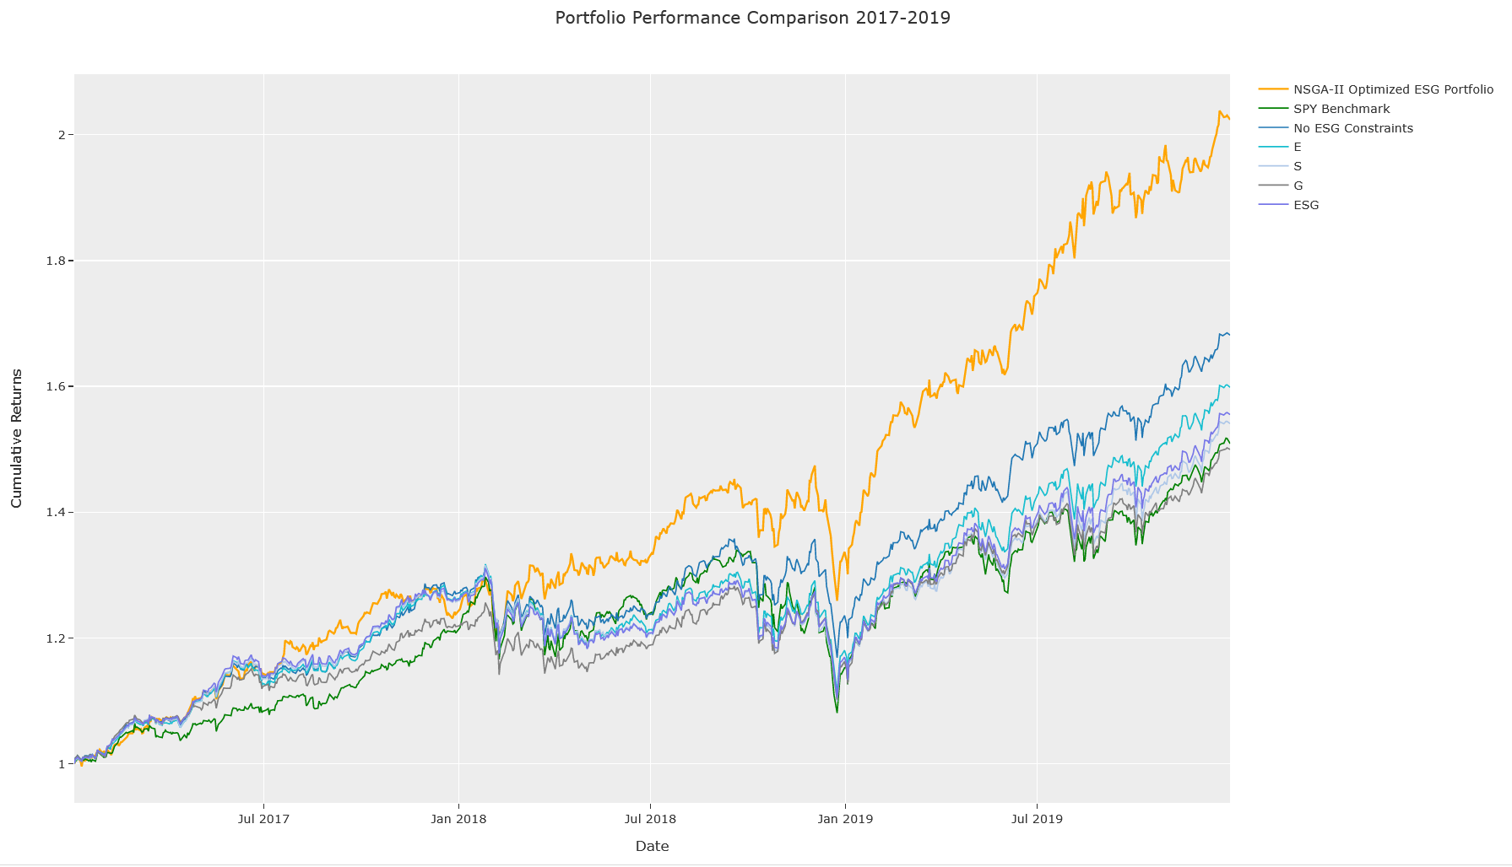

Slide 17
Portfolios | Cumulative Return | Annual Return | Standard Deviation | Beta | Sharpe Ratio | Skewness | Kurtosis | Maximum Drawdown
No ESG Constraints | 78.35% | 21.40% | 11.06% | 0.77 | 1.63 | -0.41 | 3.76 | -16.01%
E | 72.00% | 19.93% | 11.08% | 0.77 | 1.52 | -0.53 | 4.2 | -14.75%
S | 68.69% | 19.15% | 10.91% | 0.75 | 1.48 | -0.57 | 4.39 | -13.93%
G | 58.64% | 16.72% | 10.87% | 0.74 | 1.29 | -0.55 | 3.95 | -14.74%
ESG | 67.38% | 18.84% | 10.78% | 0.74 | 1.47 | -0.60 | 4.06 | -13.68%
NSGA-II Optimized ESG Portfolio | 102.38% | 26.65% | 11.98% | 0.74 | 1.87 | -0.36 | 2.5 | -13.68%
SPY Benchmark | 50.89% | 14.78% | 12.83% | 1.00 | 0.98 | -0.60 | 5.52 | -13.68%

Slide 18


Slide 19
Thank you!

